Slide 1
The book of recipes written by:
Gli alunni delle classi Seconda A e B
Scuola Secondaria Primo Grado
Gemonio

Slide 2
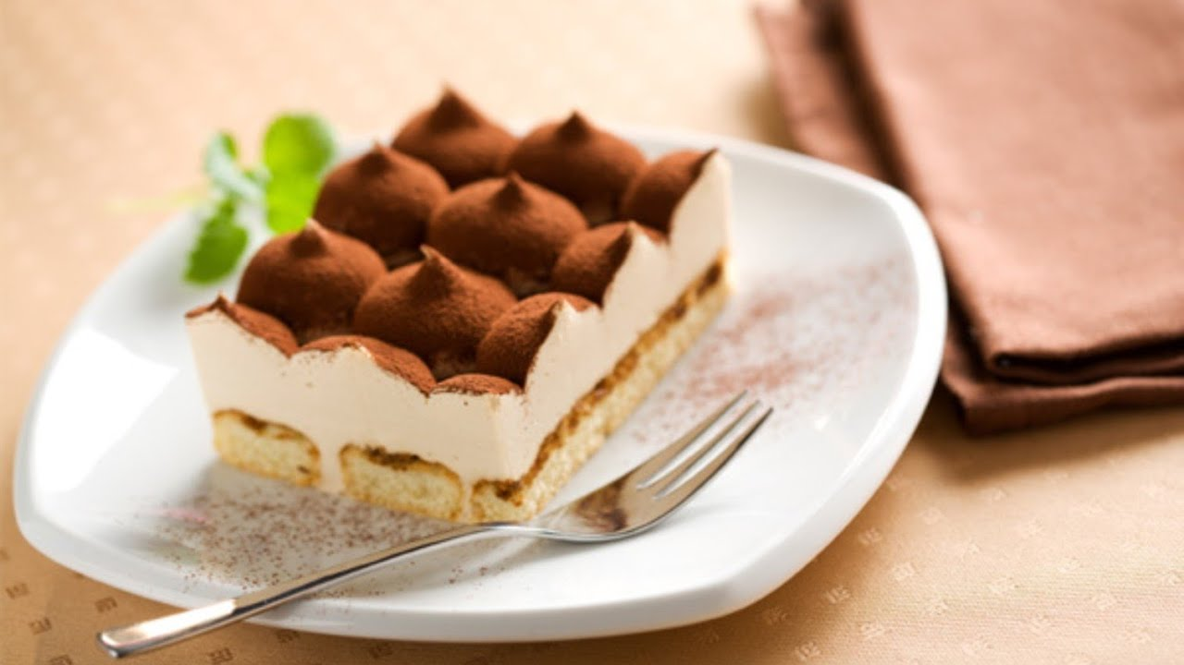
TIRAMISU’

Slide 3
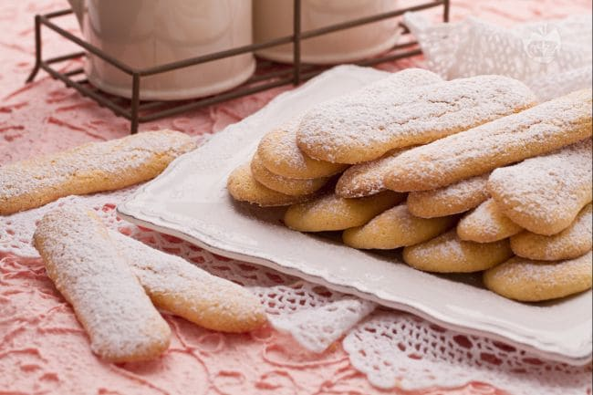
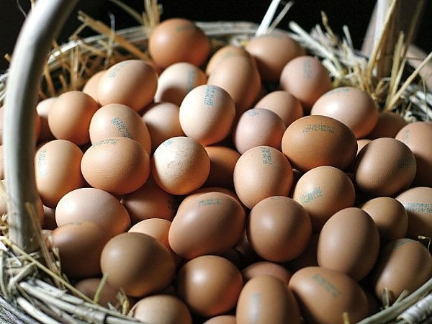
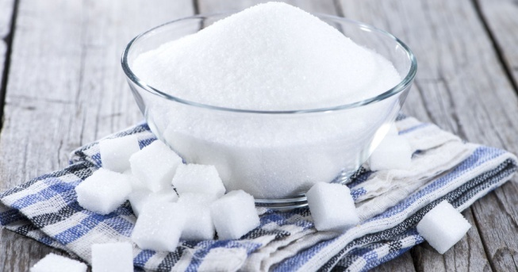
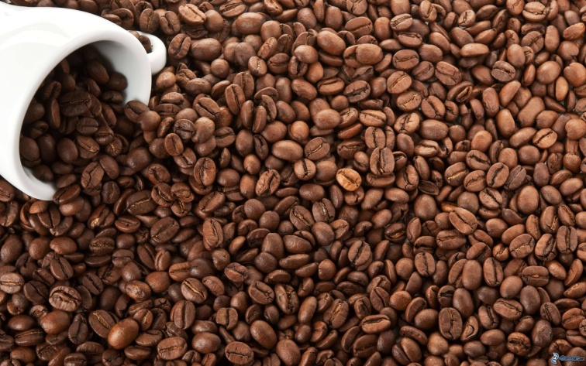
Ingredients
300g savoiardi biscuits
500g mascarpone cheese
300g coffee
4 eggs
100g sugar
To be continued

Slide 4
Instructions
Separate the egg white from the yolk. Whisk the egg white and
add 50 gr sugar.
When the mixture is light and fluffy add mascarpone cheese very
slowly. When the cream is dense, put it on one side
Whisk the egg whites and the remaining sugar slowly.
Mix in the egg whites.
When the mixture is ready, spread a spoonful of cream on the bottom of your
baking tin.
To be continued

Slide 5
Dip savoiardi biscuits in cold, sugared coffee.
Make a layer of biscuits, and put some mascarpone cheese on.
Continue until savoiardi biscuits and mascarpone cheese finish.
Smooth the surface and sprinkle cocoa powder and leave to cool for two
hours in the fridge.
(Lisa Roncari)

Slide 6
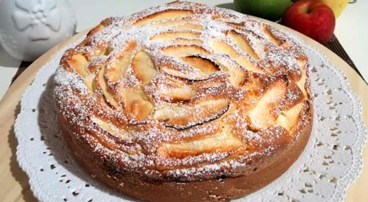
SOFT CAKE WITH APPLES
To be continued

Slide 7

INGREDIENTS:
500g GOLDEN APPLES
100g BUTTER
150g SUGAR
150g FLOUR
½ GLASS OF WATER
2 WHOLE EGGS
1 YEAST BAG
SALT

Slide 8
TIME NEEDED:
50 MINUTES

Slide 9
METHOD
BEAT THE EGGS WITH SUGAR, ADD THE MELTED BUTTER UNTIL YOU GET A SOFT CREAM.
ADD A PINCH OF SALT AND THE FLOUR MIXED WITH YEAST.
DILUTE THE COMPOUND WITH MILK. COVER A BAKING TIN WITH BUTTER AND FLOUR OR WITH OVEN PAPER. POUR THE COMPOUND INTO THE BAKING TIN.

Slide 10
COVER IT WITH THIN SLICES OF PEELED APPLES.
CARAMELIZE THE REMAINING SUGAR WITH BUTTER AND POUR IT ON THE CAKE.
BAKE IT IN A FAN OVEN FOR ABOUT 40 MINUTES.

Slide 11
AFTER 40 MINUTES CHECK THE CAKE READINESS WITH A TOOTHPICK. THE CAKE IS RAW IF THE TOOTHPICK STAYS WET, THE CAKE IS READY IF IT IS DRY.
TAKE THE CAKE OUT OF THE OVEN AND SPRINKLE IT WITH ICING SUGAR.

Slide 12

ENJOY YOUR CAKE
(Silvia De Servi)

Slide 13
Sarmalele
Sarmalele is a traditional Romanian food.
Ingredients:
500g pork
2 kg pickled cabbage
half a cup of rice
4 tomatoes
2 onions
2 tablespoons broth
4 tablespoons oil
a little dill
salt, pepper, thyme.
Preparation:
Cut all the ingredients and add them to the meat. Then take the meat and wrap it with the pickled cabbage, after put a deep pot, fill the pot with water and leave it on the fire. Fire must be neither too hot nor too light. After 45 minutes take the pot and season it with the two tablespoons of broth. Sarmalele is ready. Enjoy your meal. (David Constantin)

Slide 14
TIRAMISU’
INGREDIENTS FOR 6-8 PEOPLE...
-4 egg whites
-2 egg yolks
-100g sugar
-500g mascarpone
-4 small cups of espresso coffee
-400g savoiardi
-cocoa powder
To be continued

Slide 15
PREPARATION...
1.Make espresso coffee
2.Separate the egg yolks and the whites of two eggs in two bowls
3.Beat sugar into the egg
4.Beat the mascarpone into the yolks
5.Add two egg whites to the other two and whisk until they form stiff peaks
6. Put egg whites into mascarpone mixture
7. Dip the sides of the savoiardi in the espresso
8.Layer the savoiardi and mascarpone in a large bowl
9. Sprinkle cocoa powder on top
10.Refrigerate for one hour or two (Romeo Cracas)

Slide 16
APPLE PIE
First MELT the butter in the microwave, and keep it aside. GRATE the lemon and SQUEEZE the juice. Then set aside both the zest and the juice. Divide the apples in half and remove the core. PEEL the apples, then CUT them into four parts, and CUT them into slices by cutting them for the short side.
Put the sliced apples in a BOWL and drizzled them with the lemon juice, MIXING them well. Proceed to sift the OO flour with the baking powder. Then in a large BOWL, POUR the eggs and part of the sugar dose. Start whisk and continue POURING the sugar little by little.
When the mixture starts to lighten, add a TEA SPOON of salt, and continue WHIPPING. At this point add the MELTED butter brought back to room temperature. Season with the ground cinnamon, add the GRATED lemon zest, continuing to WHIP with the whisk, and the sifted flour and baking powder one SPOONFUL at a time. POUR the milk and POUR apples in the dough.
SPRINKLE a BAKING TIN with sugar, POUR the dough. The cake is ready to be BAKED in the OVEN to 180° for 55 minutes. (Francesco Aloisio)

Slide 17
OIL BISCUITS
- 280 GR TYPE 1 FLOUR
- 60 GR OF E.V.O.OIL
- 100 GR CANE SUGAR
- 2 WHOLE EGGS
- 1 YOLK
- 10 GR YEAST FOR CAKES
- 1/2 BERRY OF VANILLA
- 1 GRATED LEMON PEEL
- 1 PINCH OF SALT
to be continued

Slide 18
Method
“Put the eggs and sugar in a bowl, beat slightly. Add the oil and flavorings (vanilla and lemon zest), mix. Sift the flour with the baking powder. Add the flour to the egg mixture and a pinch of salt. Knead with your hands until a smooth and homogeneous mixture is obtained. Let the dough rest in a bag for 30 minutes. Roll out the dough until it reaches a thickness of 0.5 cm. Form discs or triangles to your liking. Bake in a preheated oven at 170 degrees for 7/8 minutes until desired cooking. Let the biscuits cool down and keep them in a container or bag. They can be kept for 10 days without problems. This dough can also be made into chocolate, for the little ones, simply by adding 2 tablespoons of cocoa powder. (Andrea Gagliano)

Slide 19
Trofie al pesto
Ingredients
30g. Pecorino cheese
15g. Pine nuts
100g.basil leaves
Olive oil, salt
Preparation
Chop the ingredients with the mixer
Add the salt and olive oil continue mixing
Until it is creamy
Cook trofie for four minutes
Drain trofie and put pesto sauce on it.
(Stefano Piccaluga)

Slide 20
Nutella biscuits recipe
Ingredients:
250g flour
50g hazelnuts (reduced to powder) or at the same dose of flour 00
100g sugar (extra fine)
150g of butter (cold)
1 egg
A vanilla bean or a teaspoon of vanilla extract
A pinch of salt
One or more jars of Nutella
To be continued

Slide 21
Preparation:
1) In a food processor with the blades or in a planetary mixer with the flat whisk, work the sugar with the butter into small pieces, the pinch of salt and vanilla; add the egg, hazelnut flour and the sifted flour with a pinch of yeast. Mix until you have a well-blended dough. Transfer the dough to a surface and give it a spherical shape, flatten slightly, cover it with plastic wrap feed and refrigerate for at least 40 minutes.
2) Take back the pastry, work for a little or beat at rolling pin on it (this procedure helps not to beak it). Roll out 3/4 of the pastry on a well-floured surface at a thin thickness of 4 mm. With a round cookie cutter with a diameter of 6,5 cm make many disks. Butter and flour a muffin mold. Place the pastry discs in the mold, press lightly and slightly lift the edges and puncture the background with a fork. While the oven reaches the temperature, put the basses in the fridge (this helps shape, I recommend keeping them in the fridge for at least 20 minutes). Discover the basics with baking paper and a putting some legumes not to deform the pasta when it cooks. Cook everything in a preheated oven at 180°static function, for about 15 minutes, until golden brown. Take out of the oven remove the greaseproof paper and the weights and remove gently.
To be continued

Slide 22
3) Make 4mm circles with the remaining pastry, with a small heart stencil make many small hearts to be placed in the centre of each cookie, apply light pressure cuts on the pastry disk. Put the pan in the fridge for 20 minutes before baking (helps maintain shape). Bake at 180°in a preheated static function for 10 minutes until lightly browned. Finally let it cool.
4) Fill each pastry basket with a teaspoon of Nutella, cover with a golden biscuit, apply light pressure to from the greedy border of Nutella.
Nutella Biscuits are ready To Be Enjoyed!!!!
They are kept stuffed for 4 days in airtight boxer or only biscuits without Nutella 15-20 days in airtight boxes and then stuffed at the moment.
. I created the hazelnut flour by mincing the toasted hazelnuts and adding a spoonful of sugar from the total written at the beginning.
(Annalisa Predolini)

Slide 23
Meatball egg for appetizer.
The egg in a meatball is a very rich appetizer that is easy to make and certainly successful
DIFFICULTY LOW
PREPARATION 5H 50 '
CALORIES 420 FOR 100 g
INGREDIENTS
eggs 8 Finely ground sausages 100 g Ground beef 200 g Bread 1 slice Milk Just enough Parmesan Cheese 40 g salt Just enough pepper Just enough Bread crumbs Just enough Flour Just enough Seed oil Just enough.
EGG PREPARATION IN MEATBALL
1 Boil 6 eggs for 5 minutes and set aside. In a bowl put the two types of meat, the bread soaked in milk and then squeezed, the egg, the grated cheese, the salt and the pepper. Work the ingredients with your hands to make the dough homogeneous. 2 Peel the hard-boiled eggs and flour them. Take a portion of meat about the size of a plum, flatten it well and use it to wrap a hard-boiled egg, so that it is perfectly covered. 3 Press well with your hands to compact the meat and pass the meatball thus obtained first in the beaten egg and then in the breadcrumbs. Do the same for the other hard-boiled eggs. 4 Put a pan with deep oil on the heat and fry the eggs in a meatball. Keep the flame not too high, so as not to burn them. Serve them hot or cold, ith mixed salad. They are also excellent to consume during a picnic.
(Daniele Adriano)

Slide 24
SHOPPING LIST
1kg 00 flour
1kg Granulated white sugar
250g Butter
1 Pumpkin
6 Eggs
500g of fresh cream
Cloves
Jamaica pepper (optional)
PUMPKIN PIE
8 people | 2h & 30 min| 3h & 25 min
INGREDIENTS
Dough:
160g/ 00 flour
2 spoons of granulated sugar
¼ tea spoons of salt
115g/ cold diced butter
4-6 table spoons of cold water
Filling:
440g/pumpkin puree
200g/ granulated sugar
3 big eggs
240g/fresh cream
¼ tea spoons of nutmeg
¼ tea spoon of mashed cloves
¼ tea spoon of mashed Jamaica pepper (optional)
¼ tea spoon of salt
To be continued

Slide 25
METHOD
Put the flour, the sugar, the salt and the butter in a kitchen robot and mix to obtained a mealy compost. Add 4 table spoon of cold water and operate again the kitchen robot until the dough starts to compact. If the dough was still too dry add a table spoon of water. Work the dough quickly, do a ball and then flat it. Wrap it in a transparent film and put it in the fridge for 2 hours.
Preheat to 220 °C. Roll the dough on a floured work surface, then transferred it in a baking tin with a diameter of 22cm and make it stick to the edge and the bottoms. Cut the excess dough leaving about 2 cm of feed over the edges. Fold the excess pasta back down and mash it with a fork or with your hands. Let the pan to rest in the refrigerator for 20 minutes.
To be continued

Slide 26
3. Remove the cake pan from the refrigerator, coat the dough with a sheet of aluminum foil, resurface with a layer of dry beans and bake for 25 minutes, until the dough is dry and solid. Lower the oven temperature to 180 ° C, remove the foil and beans and continue cooking for about 10 minutes until lightly browned. In the meantime, prepare the filling.
4. For the filling, mix the pumpkin, sugar, eggs, spices and the salt in a bowl.
5. Pour the filling into the pan (if it is still in the oven, it is easier to remove the pan from the oven than to try to pour the filling while it is on the grill) and continue cooking for another twenty minutes, until the filling begins to simmer at the edges and it has a dry appearance. The filling will be soft when you take the cake out of the oven, it will solidify upon cooling. Serve at room temperature with a little whipped cream. To be continued

Slide 27
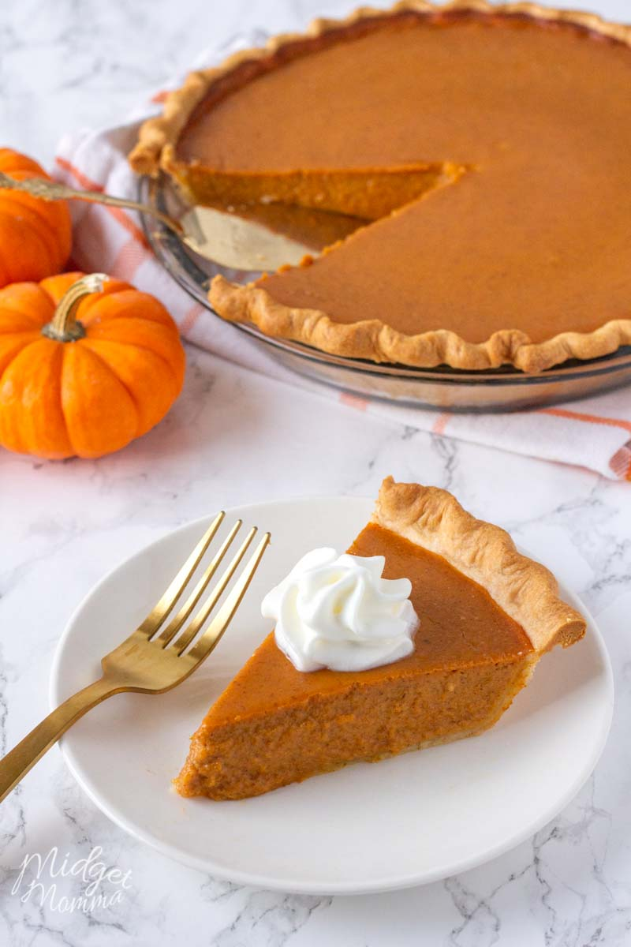
(Francesca Foschino)

Slide 28
TIRAMISU
6 medium eggs
500 g of Mascarpone
150 g of sugar
6 medium eggs
300 g of Savoiardi biscuits
8 cups of cold coffee (prepared with moka)
50 g of brandy
sifted bitter cocoa
(Tobia Magrin)

Slide 29
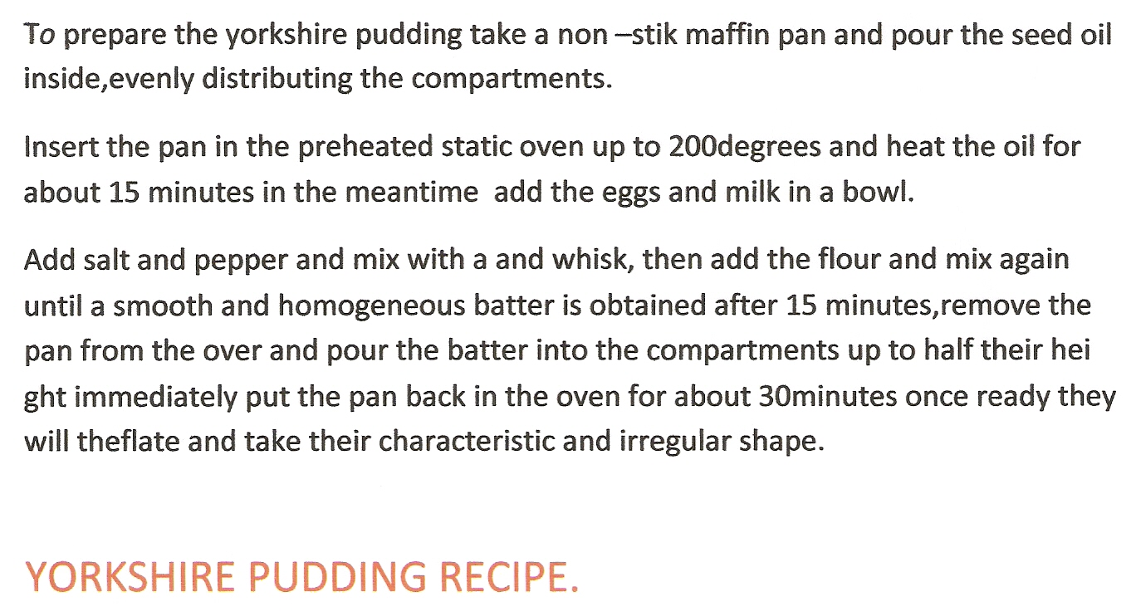
(Ivan Di Giambattista)

Slide 30
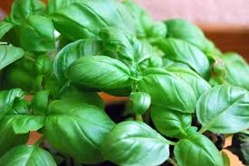
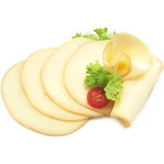
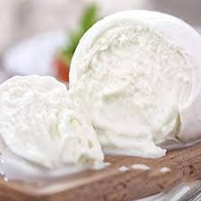
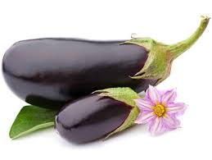
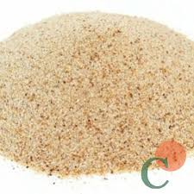
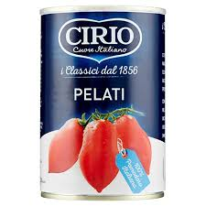
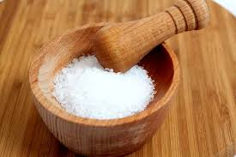
Eggplant parmigiana
Ingredienti
1Kg eggplant
240 gr mozzarella cheese
120 gr sliced of smoked scamorza cheese
420 gr peeled tomatoes
Salt, origan, basil,breadcrumbs
To be continued

Slide 31
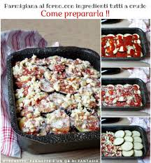
Preparation
Wash and slice the aubergines, grill them, season with basil, salt and tomato.
In a oven pan arrange the aubergines, tomatoes, mozzarella, origan.
At the end add scamorza cheese and some breadcrumbs
To be continued

Slide 32
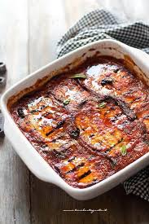
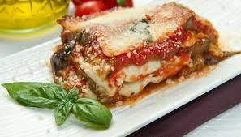
Cooking
Put in oven at 150 degrees for 20 minutes
(Agnese Del Fatti)

Slide 33
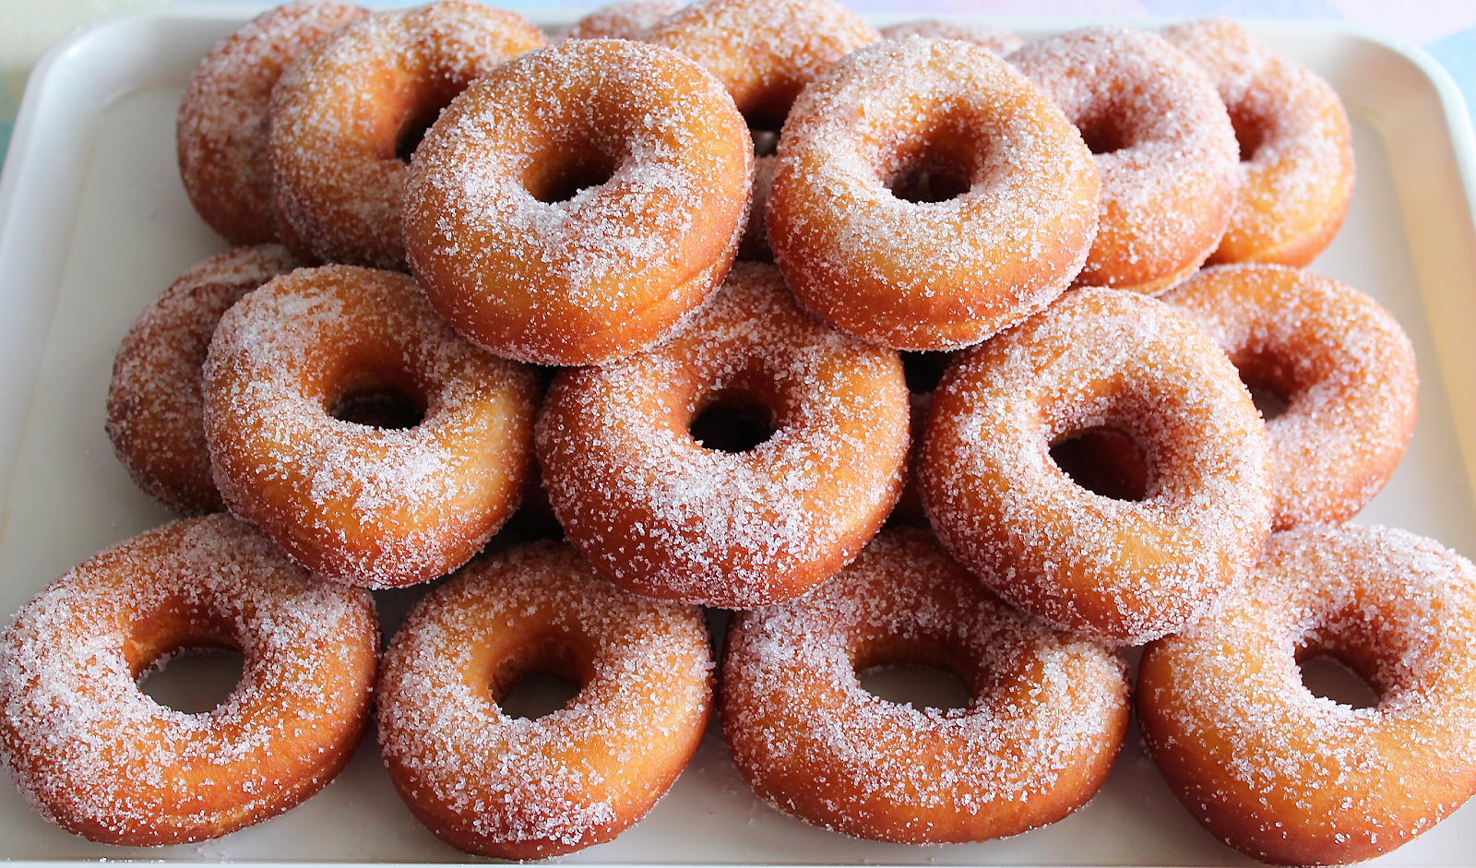
Donuts (ciambelle)
To be continued

Slide 34
Ingredients
500 gr flour
250 ml milk
50 gr butter
50 gr sugar
35 gr brewer's yeast
2 eggs
2 spoonful of oil
1 lemon
Salt
To be continued

Slide 35
Preparation
Mix eggs, salt, sugar and lemon,
Add butter and flour,
finally brewer's yeast with milk.
Mix for a long time.
Let rest for two hours.
Shape a few donuts and fry,
Strew with icing sugar.
(Syrya Ciampi)

Slide 36
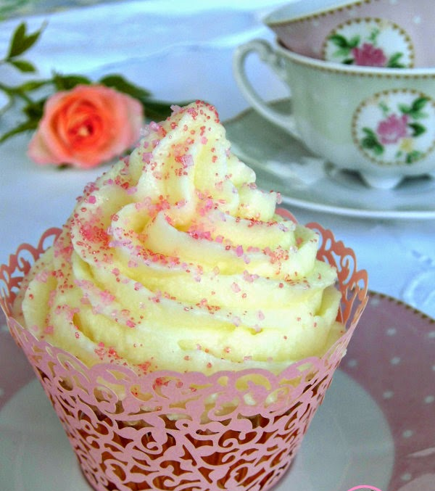
VANILLA CUPCAKES
To be continued

Slide 37
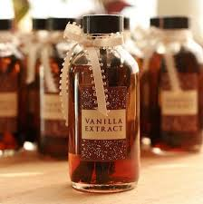
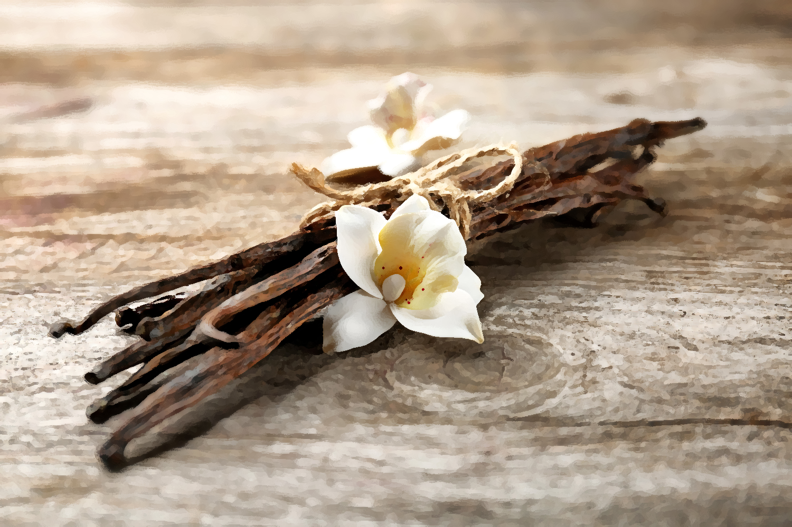
RECIPE FOR VANNILLA CUPCAKES
INGREDIENTS FOR 12 CUPCAKE: for the sponge cake: 2 eggs 120 g flour 120 g butter 120 g sugar 3 tablespoons of milk 3 teaspoons of baking powder 2 teaspoons of vanilla extract (prepared with 100 g sugar, 100 ml water and a teaspoon of vanilla)
To be continued

Slide 38
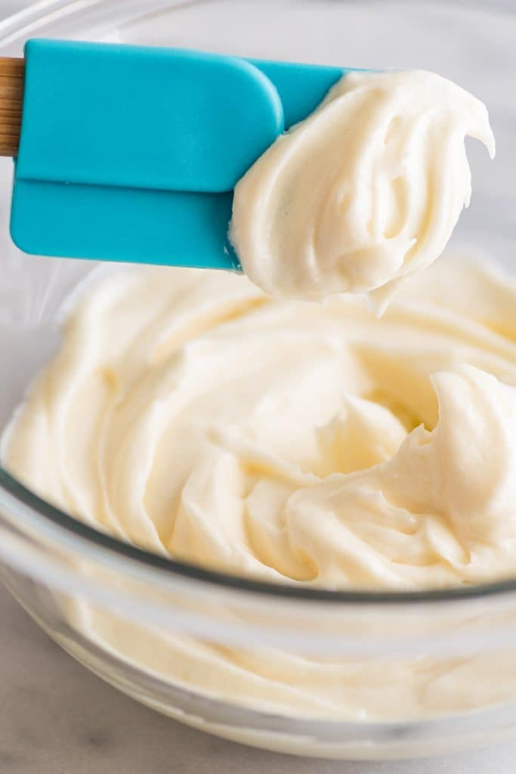
For frosting: 250 g butter at room temperature 450 g icing sugar 6 teaspoons of milk 1 teaspoon of vanilla extract
To be continued

Slide 39

PREPARATION
Preheat the oven to 170°;
in a bowl work the butter with the sugar until creamy and then add 2 beaten eggs together with the vanilla extract and then add the sifted flour and baking powder, add the milk and mix all the ingredients.
Prepare a muffin pan with 12 baking cups and distribute the dough for 2/3 of its capacity. Bake for 35 minutes.
Check the cooking of the cupcakes with a toothpick.
When they are ready, let them cool and then brush them with the vanilla extract.
To be continued

Slide 40

FROSTING PREPARATION:
While baking the cupcakes prepare the frosting:
Put all the ingredients in a bowl except the icing sugar and work with low speed electric whisk. Then add the icing sugar little by little and work at maximum speed for 5 minutes.
Use frosting to garnish the cupcakes.
(Marta Sartorio)

Slide 41
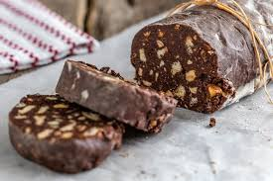
Chocolate salami
To be continued

Slide 42
Recipe
200 g biscuits
100 g butter
100 g sugar
100 g bitter cocoa powder
2 eggs
To be continued

Slide 43
How to cook
1. Break the biscuits.
2. Melt the butter in a small pot.
3. Add cocoa to butter.
4. In a bowl, beat the eggs and the sugar together.
5. Add the mixture of cocoa and butter.
6. Add the biscuits and stir.
7. Shape the mixture into a salami.
8. Spread the salami with the bitter cocoa powder.
9. Put in the fridge for 3-4 hours.
(Federico Martinoia)

Slide 44
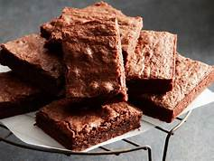
COOK THE BROWNIES
To be continued
Notes:
44

Slide 45
INGREDIENTS
225 g of dark chocolate
4 big eggs
225 g butter
135 g flour 00
255 g granulated sugar
1 pinch of fine salt
15 g of bitter cocoa powder
1/2 teaspoons of baking powder
To be continued
Notes:
45

Slide 46
PROCEDURE
Melt the chocolate in water bath with butter (low heat), to obtain a liquid and smooth compound. Let it cool.
Mix flour with baking powder, salt and cocoa
Whip eggs and sugar, up to obtain a clear and triplicate compound of volume
Pour the chocolate mixture in the eggs, mix from bottom to top with a spatula, until it becomes a soft and compact cream.
Add the flour sifting and mix with a spatula from bottom to top. The dough must be thick and must fall to a heavy belt.
Pour in a baking pan covered with oven paper
To be continued
Notes:
46

Slide 47
Don't pour the brownies in a baking pan because it will be difficult to chop and detach the squares.
Level the dough
To be continued
Notes:
47

Slide 48
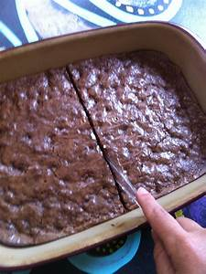
cooking
Don't forget to preheat the oven at 180°
Bake the brownies in the part medium high of the oven for 30 minutes
To be continued
Notes:
48

Slide 49
FOR SERVE
Let the mixture cool in a baking pan for 5 minuties.
Lift with all the oven paper and completely cool on a grate
When it is cold cut into squares and serve
(Anita Maierini)
Notes:
49

Slide 50
RISOTTO MILANESE
INGREDIENTS
350 g. carnaroli rice
50 g. butter
40g . beef bone
½ onion
1 litre of hot beef stock
100ml white wine
0,15 g. Saffron powder
60 g. grated parmesan cheese
Salt
To be continued

Slide 51
Directions
Put butter in the pan and melt it
Add onion
Add rise
Add bone marrow
Stir rise and butter
Add the white wine and stir for 5 minute
Add the chicken stock and stir for 15 minutes
Put salt
Add saffron powder
When the rise is cooked al dente add the Parmesan cheese
Add some butter.
The risotto is ready
(Achraf Khayal)

Slide 52
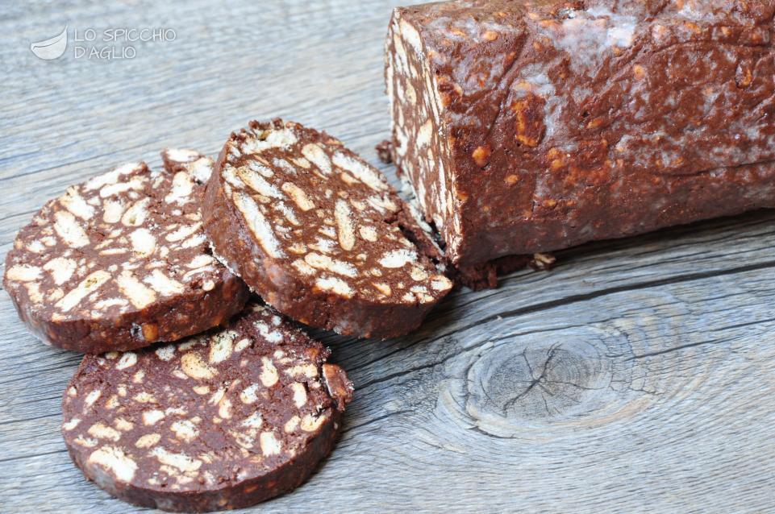
Chocolate salami
To be continued

Slide 53
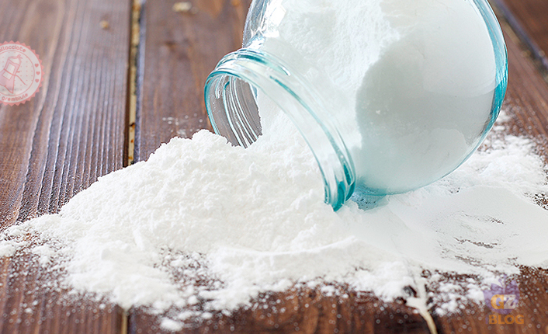
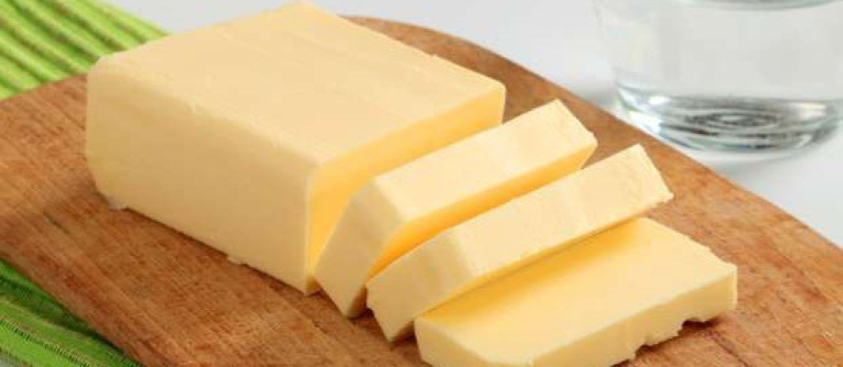
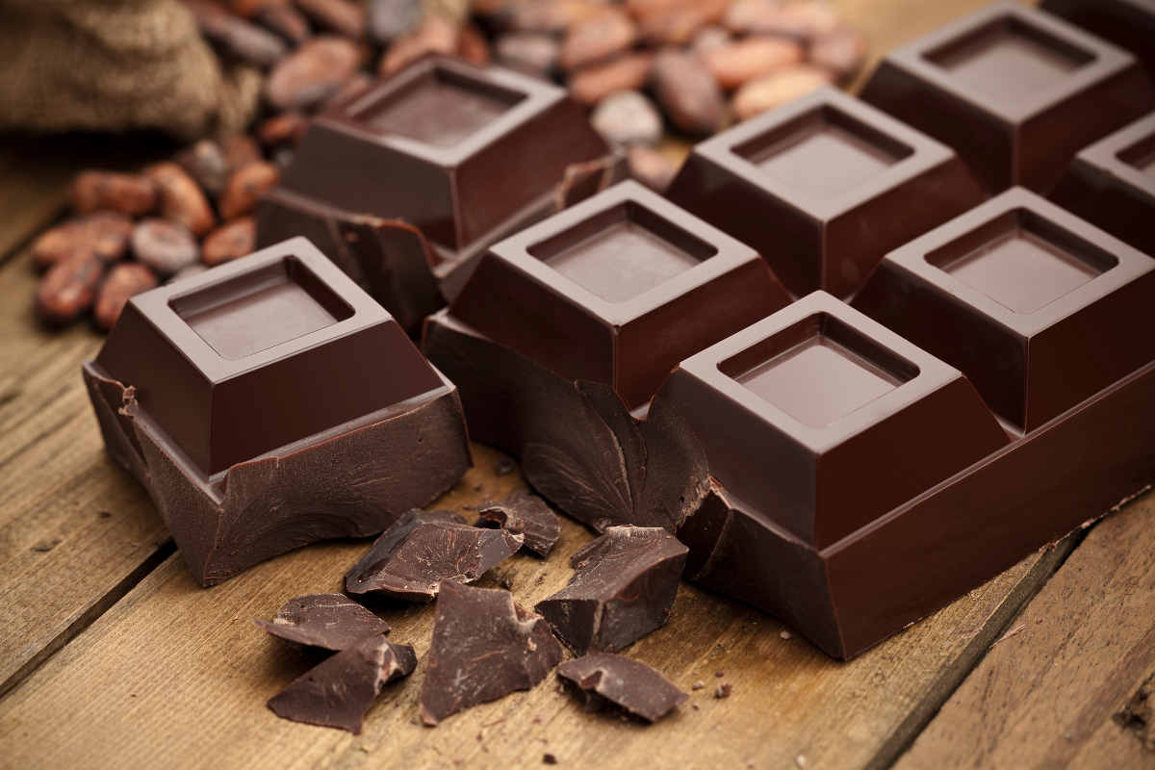
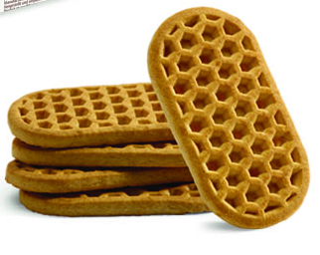
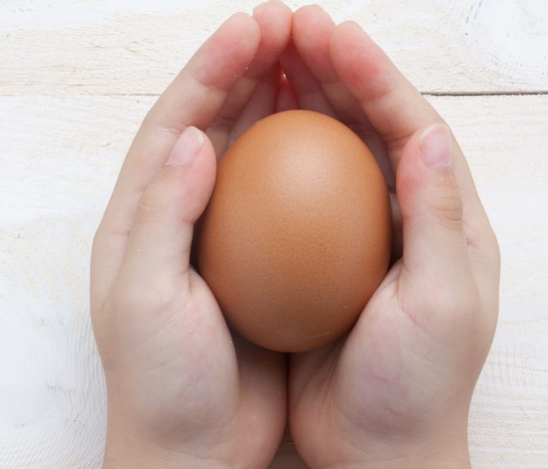
chocolate salami recipe
Ingredients:
200 g biscuits
150 g dark chocolate
150 g butter
150 g icing sugar
1 egg
To be continued

Slide 54
INSTRUCTIONS
Soften the butter in the microwave for about 20 seconds and then mix the butter with the sugar in a steel bowl. Now add an egg to the dough.
Melt the chocolate, placed in a bowl, in the microwave for about a minute.
When the chocolate has melted mix it into the dough, crumble the biscuits and stir them into the dough.
Drop the dough onto the baking paper and start giving it the shape of a salami with the help of a spoon.
To end the dessert, insert the salami in a blast chiller at minus 30 degrees and let it rest for half an hour.
Dessert is ready to be tasted.
(Aurora Sartorio)

Slide 55
ALBANESE BAKLAVA
500g phyllo dough
200g chopped walnuts
Cinnamon powder
180g melted butter
Ingredients for the syrup
50g honey
450g sugar
300 ml water
2 theaspoon of lemon juice
To be continued
Notes:
55

Slide 56
Syrup
Melt the honey and lemon juice in water and after a few minutes when it becomes thick, remove from the heat and let it cold in the refrigerator
To be continued
Notes:
56

Slide 57
Preparation
Paint 6 phyllo dough with melt butter and then put some chopped walnuts and cinnamon on, then put 6 more phyllo with the same procedure
Take a sharp knife and cut it to form rhombuses
Bake 40 minutes at 180° just the time to cook and turn it golden
As soon as it is removed from the oven immediately put the sauce that we had cooled and let it fit well into the holes, let cool and serve.
To be continued
Notes:
57

Slide 58
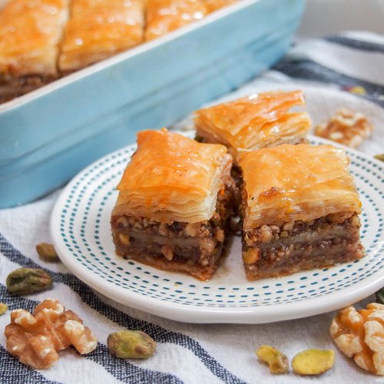
Baklava is a very caloric dessert, so be careful
with the portions.
(Martina Selmanaj)
Notes:
58

Slide 59
Carbonara
Ingredients
350 g spaghetti 120 g pork cheek (bacon)
30 g roman pecorino 20 g grated parmesan
2 large yolks Salt
Pepper
For 4 people
Preparation
1 Cut the bacon into sticks
2 Mix the yolks with pecorino and the parmesan. Add 40 -50 g water.
Mix with a whisk so that the yolks become creamy.
Salt and pepper.
To be continued

Slide 60
3 Put a pot of water on the fire and let it boil. Meanwhile, cook the bacon in a pan without oil, on low heat: brown it until it becomes crispy (about 7-8’). Cook pasta. Beware its cooking time: it must be ready together with bacon, so that it can be seasoned immediately.
4 Drain the pasta al dente, without drying too much (alternatively, keep a little cooking water), and put it back in the pot or in a glass bowl: it is important that the pasta is seasoned off the heat. Season immediately with the bacon and its fat. Mix well.
5 Pour the egg yolk mixture over the spaghetti and stir, so that it hardens slightly, without making lumps, always away from the heat. Serve immediately, completing with other pecorino cheese to taste and a minced pepper.
(Arianna Fortina)

Slide 61
Pizza
Put flour in a bowl
Add warm water, salt, olive oil, yeast.
Mix well with a wooden spoon.
Leave it to set for 10 minutes
Roll the pasta in large rounds.
Mix the sauce with olive oil.
Put the sauce on the top , put also small pieces of mozzarella cheese.
Bake the pizza ten , fifteen minutes in the oven.
Eat with whatever topping you like.
(Stefano Giordano)

Slide 62
CHOCOLATE CUPCAKES GLUTEN FREE
INGREDIENTS:
200g rice flour
170g corn starch
1 egg
100g sugar
50g butter
100ml milk
½ sachet of instant yeast
1 sachet vanillin
100g chocolate
PREPARATION
In a large bowl, put the rice flour, the corn starch, the vanillin, the sugar and the instant yeast. Mix everything. In another bowl, beat the melted butter with the egg and add the milk. Work the mixture until obtain a homogeneous consistency. Mix the ingredients and add the chocolate. Fill the cups and bake at 180°C for 20minutes.
(Matteo Mercante)

Slide 63
PLUMCAKE
4 EGGS
200 g SUGAR
2 JAR WHITE YOGURT
90 g SUNFLOWER OIL
300 g FLOUR 00
1 SACHET OF YEAST
BREAK THE EGGS IN A BOWL, MIX WITH THE WHISK THEN ADD SUGAR.
KEEP ON MIXING, POUR IN THE YOGURT, SUNFLOWER OIL AND START ADDING THE FLOUR LITTLE BY LITTLE.
FINALLY, ADD THE BAKING POWDER.
POUR THE DOUGH INTO THE BOWL AND PUT IN THE OVEN FOR 20 MINUTES AT 180°C
(Arianna Conte)

Slide 64
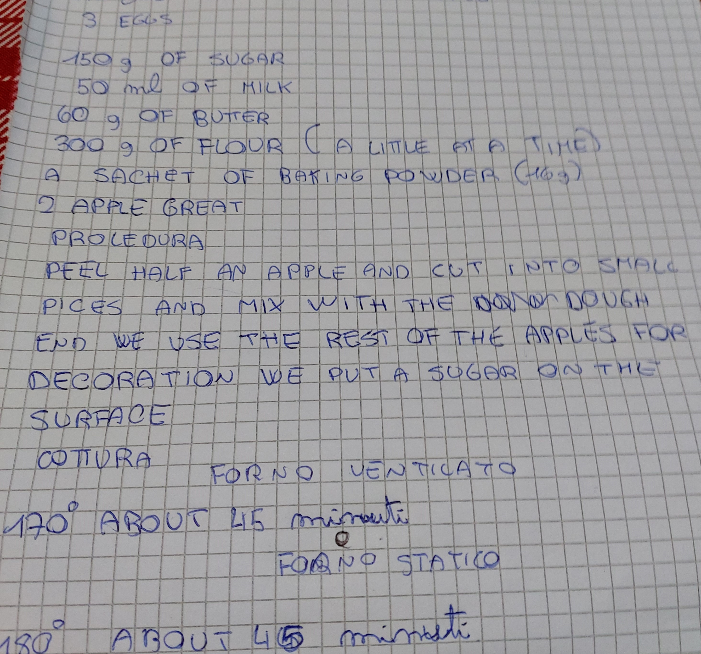
Apple cake (Jacopo Garofalo)

Slide 65
PESTO SAUCE
To be continued

Slide 66

PREPARATION
(Gabriele Rossi)

Slide 67
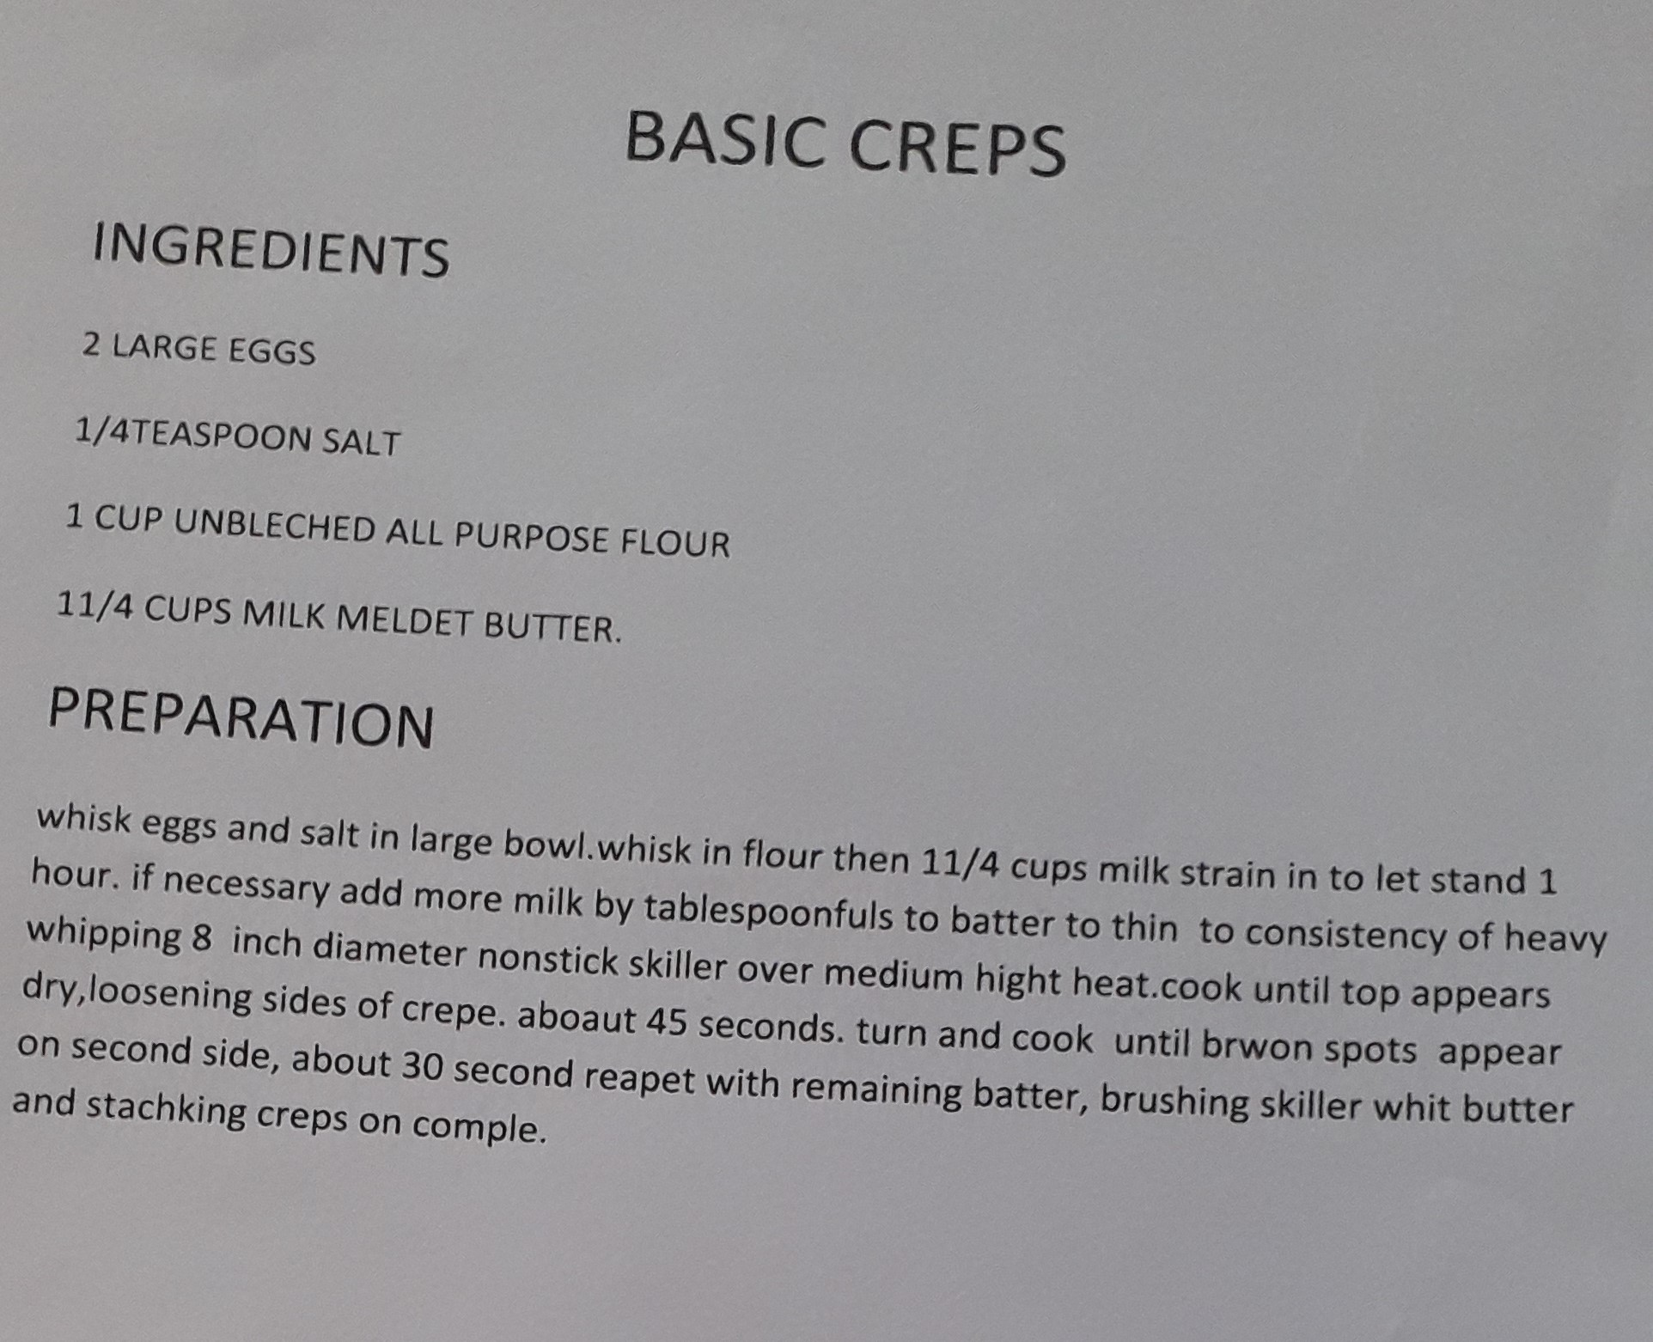
(Kevin Brahushaj)

Slide 68
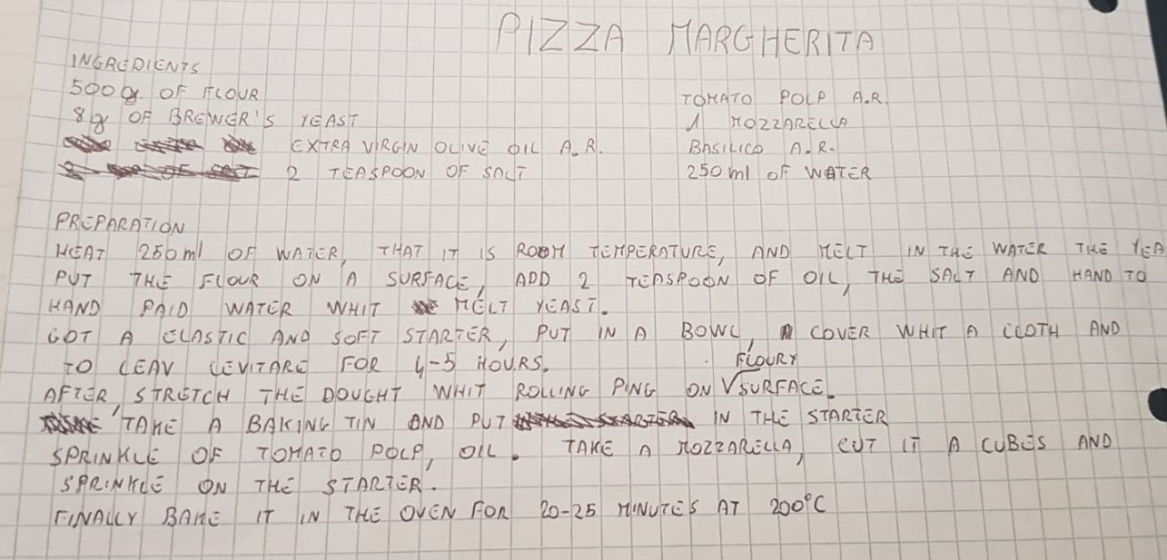
(Dennis Dinca)

Slide 69
APPLE CAKE
INGREDIENTS
300 g flour
3 apples
250 g sugar
3 eggs
70 g butter
200 ml milk
16 g baking powder
1 lemon
To be continued
Notes:
69

Slide 70
HOW TO MAKE IT?
Wash the apples, peel them and remove the core. Chop the apples, put them to macerate with a little sugar and some lemon juice in a bowl.
Whip the yolks with sugar to get a light and scummy cream. Leave aside the egg whites.
To be continued
Notes:
70

Slide 71
HOW TO MAKE IT?
Put the sifted flour, the melted butter and the milk. Mix everything with the apples into smaller pieces and put them in the mixture. Add the sifted yeast and mix it with the mixture. Whip the egg whites and put them in the mixture slowly. Mix them from the bottom to the top slowly and a little at a time.
To be continued
Notes:
71

Slide 72
HOW TO MAKE IT?
Pour the mixture in a 24 cm buttered and floured baking tin. Put the sliced apples on the top of the mixture. Bake the apple cake in the hot static oven for about 40 min at 180° C. Try with a toothpick if it is ready. Finally, sprinkle the cake with icing sugar.
To be continued
Notes:
72

Slide 73
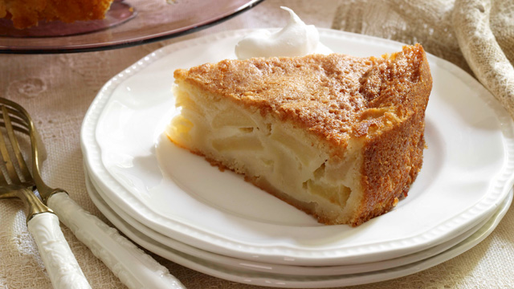
(Irene Rovera)

Slide 74
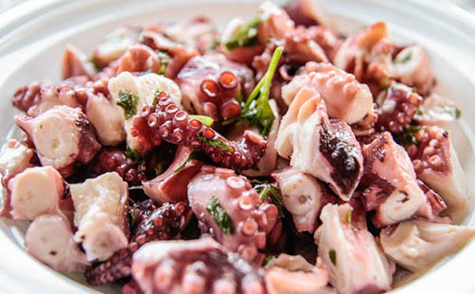
Octopus Salad
To be continued

Slide 75

Sardinian octopus salad is usually served as an appetizer. The main ingredient is obviously the local octopus which is generally a little smaller than normal and this makes it more delicate. It is served with boiled potatoes, celery and seasoned with olive oil, lemon, garlic and parsley.

Slide 76
Ingredients
One octopus of about one kilo
Oil and vinegar to season
One deck of parsley
One clove of garlic
Fine salt
One tablespoon of coarse salt
Cherry tomatoes
Black olives

Slide 77
Recipe
Clean the octopus well eliminating eyes and entrails. Then put it in a saucepan with hot water and before cooking, immersing it for three times taking it by one end. Boiled it for 30 minutes then when it is tender, switch off the flame and let it cool down in the same saucepan with the boiled water. Now chop it and transfer it to the bowl.

Slide 78
Clean the octopus from the woody parts then season it with cut celery and parsley, salt, lemon juice and oil.
Mix everything and let it rest in the fridge for at least 1 hour. After you can serve it with potatoes.
(Tommaso Bosè)

Slide 79
To be continued

Slide 80
To be continued

Slide 81
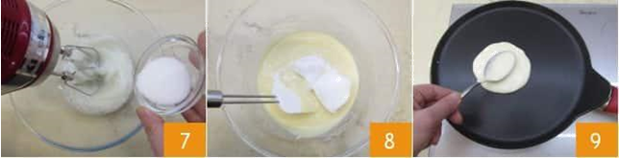
To be continued

Slide 82
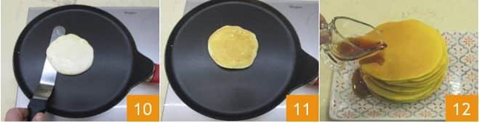
(Amelia Favaro)

Slide 83
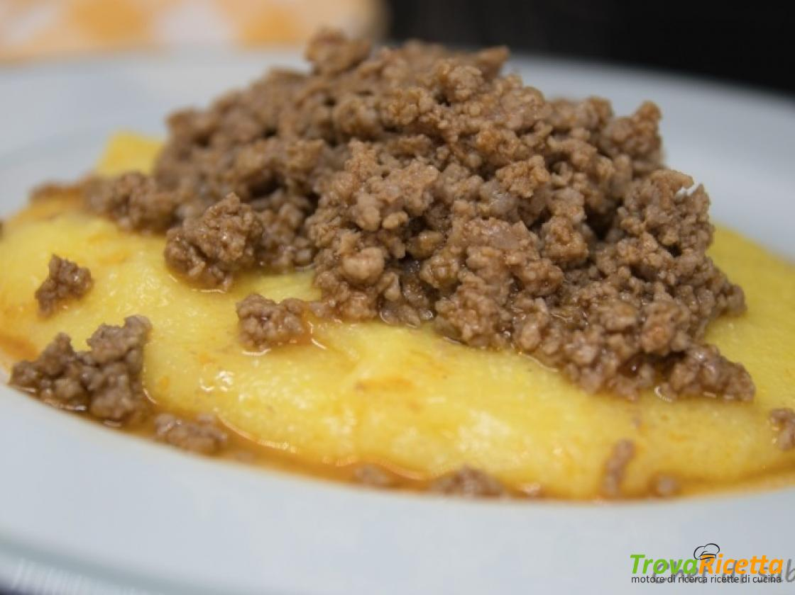
POLENTA AND BRUSCITTI
To be continued

Slide 84

WHAT IS THAT
WIDESPREAD IN THE NORTHERN AREA OF ​​LOMBARDY, POLENTA AND BRUSCITT IS A TYPICAL BUSTO ARSIZIO SPECIALTY OF WHICH THE BUSTOCCHI, THE CITIZENS OF BUSTO, ARE VERY PROUD.
GOING TO THE BUTCHERS OR RESTAURANTS OF THE CITY, YOU WILL HAVE TO ASK FOR BRUSCITTI, THE ORIGINAL NAME WHICH, IN THE VARIOUS DIALECTAL INFLECTIONS, HAS LOST ITS FINAL VOWEL.
THE BRUSCITT ARE STRIPS OF BEEF BROWNED IN A PAN WITH BUTTER AND LARD, FLAVORED WITH GARLIC AND WILD FENNEL SEEDS, WHICH ARE LEFT TO COOK ON A LOW HEAT FOR A COUPLE OF HOURS AND ARE BLENDED, AT THE END OF COOKING, WITH RED WINE, USUALLY BARBERA , NEBBIOLO OR BAROLO.
THE BRUSCITTS ARE THEN SERVED WITH STEAMING YELLOW POLENTA, TO DIP IN THE DELICIOUS MEAT SAUCE.
To be continued

Slide 85

INGREDIENTS
FOR THE MEAT
SALT TO TASTE.
BUTTER 100 G
PEPPER AS NEEDED.
COLONNATA LARD 45 G
FENNEL SEEDS 5 G
GARLIC 1 CLOVE
BARBERA RED WINE 200 ML
BEEF REAL PULP 1 KG
BEEF PRIEST'S HAT 1 KG
FOR THE POLENTA
CORN FLOUR 375 G
WATER 1.5 L
SALT UNTIL Q.B.
EXTRA VIRGIN OLIVE OIL 1 SPOON

Slide 86
HOW TO PREPARE
TO PREPARE THE POLENTA AND BRUSCITT, TAKE THE BEEF AND DEGREASE IT FROM EXCESS FAT THEN CUT IT INTO LARGE CHUNKS HALF A CM 2; CUT THE LARD INTO THIN STRIPS.
MELT THE BUTTER AND LARD IN A LARGE ENOUGH PAN . ADD THE MEAT , ADD SALT AND PEPPER AND ADD SOME FENNEL SEEDS AND A CLOVE OF GARLIC.
COVER WITH LID 1 AND COOK FOR AT LEAST 2 HOURS ON LOW HEAT, STIRRING EVERY 20-30 MINUTES
THE MEAT WILL BE QUITE SOFT: RAISE THE FLAME AND BLEND WITH THE RED WINE . LEAVE ON THE FIRE FOR 5 MINUTES AND YOUR BRUSCITTI WILL BE READY SERVE THEM WITH POLENTA AND SLICES OF TOASTED BREAD IN THE OVEN.
(Federico Giavini)

Slide 87
Sbrisolona
200 g flour 00
100 g corn flour
120 g sugar
100 g peeled almonds
120 g butter
1 egg yolk
1 tablespoon of grappa
1 lemon
Salt
For the baking tin:
butter and flour
To decorate:
1 tablespoon of sugar
a handful of unpeeled almonds
To be continued

Slide 88
Preparation:
Pour the almonds in the mixer with 2 tablespoon of sugar and mix for a few second to obtain a coarse mince.
Sift two flours in a large bowl and add the grated lemon zest, the mince of almonds and sugar, a pinch of salt and the sugar. Mix the ingredients, then add the chopped butter, some grappa, and the egg yolk.
Knead quickly by rubbing with the fingertips so that a homogeneous dough is not formed but a set of lumps, trying mash the pieces of butter to incorporate the flours.
Grease with the butter a 28 cm baking tin (the Sbrisolona must not be more than 2 cm high) and drop the lumps of the dough without leveling the surface.
Finally sprinkle the surface with the almonds and put the cake in the oven at 200° for 30 minutes until it turns golden. When cooking is complete, let the Sbrisolona cool in the baking tin and then sprinkle it with the sugar.

Slide 89
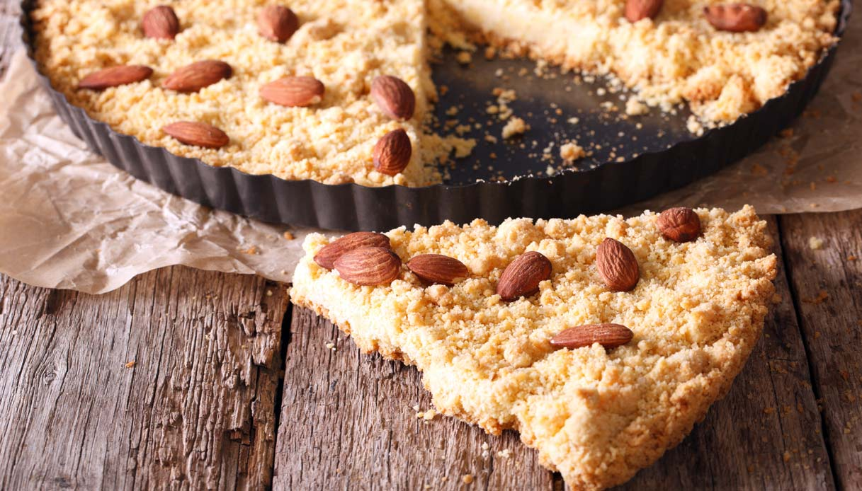
Origins of the Sbrisolona:
The Sbrisolona or Sbrisolina is a Mantovana cake. It is called this way because it is a cake that crumbles between the fingers.
It is a dessert of peasant origin. It is provided by poor flours such as corn and lard instead of butter.
It was also called the “three cup cake” because you need three cups: a cup of yellow flour, a cup of white flour and a cup of sugar.
Later the cake was enriched thanks to the addition of spices and almonds.
The Sbrisolona is a rich and certainly not dietetic dessert!
(Giorgia Franzolin)

Slide 90
LASAGNA
INGREDIENTS :
Home made ragout
Puff pastry for lasagna
Bechamel
Ham
Cheese
To be continued

Slide 91
PREPARATION:
1) Prepare your ragout with carrots, celery and onion.
2)Once the sauce is ready add the bechamel and mix slowly.
3) Take a sheet of lasagna and cover it with the ragout and ham.
4)Put on lasagna some cheese.
5)Then put it in the oven at 180 degrees and cook for about half an hour. Once cooked we can sit it at the table and eat this delight.

Slide 92
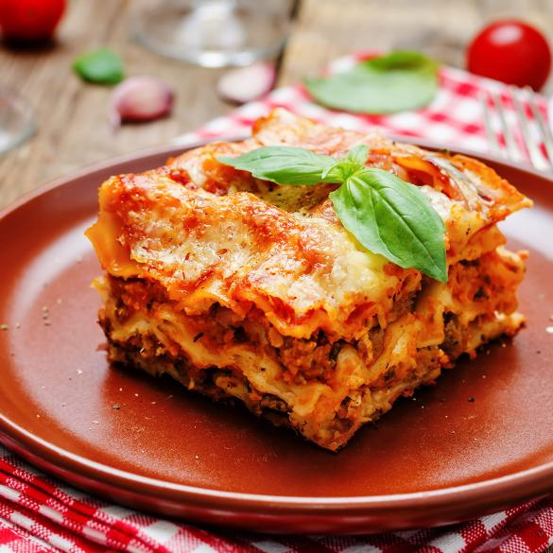
(Noemi Pala)

Slide 93
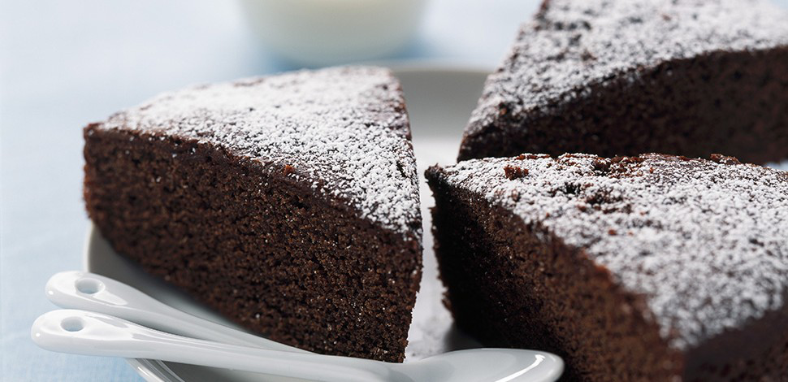
DARK CHOCOLATE CAKE
To be continued

Slide 94
Ingredients
3 Eggs
200 g Flour 00
120 g Dark chocolate
25 g Bitter cocoa powder
100 g Butter (or 80 g seed oil)
150 g Sugar
1 Sachet of baking powder
Icing sugar to decorate

Slide 95
Preparation
Cut the dark chocolate in pieces and melt it in the microwave or in a water bath, keep it aside and let it cool.
Whip the eggs and the sugar with the electric whisk at full speed.
Add at the wiped eggs the welt butter ( or the seed oil )
Add at the mixture the melt dark chocolate and mix it with the whisk
Sift together : flour, cocoa, butter and baking powder
Add little at the time the powder at the mixture of eggs, butter and chocolate; and keep on mixing the dough lowering the speed of the whisk
Grease and flour a cake pan and put the mixture in.
Bake the cake in a static oven, preheated at 170 ° for about 30/35 minutes,
Make you sure the cake is cooked by inserting a stick in the center : if the stick is wet the cake is not cooked, if it isn' t the cake is cooked.
Remove the chocolate cake from the oven and let it cool
Sprinkle with icing sugar, or with whipped cream
(Greta Ossola)

Slide 96
Soft heart nutella donut
A 125 g jar of whole white yogurt
200 g of sugar
3 eggs
100 ml peanut oil
280/300 gr of flour 00
1 lemon vial
1 sachet of yeast
Enough of nutella
INGREDIENTS
To be continued

Slide 97
PREPARATION
Use a silicone mold or the ice cubes mold, pour the nutella and freeze it for at least 2 hours.
Pour the yogurt with the sugar and the eggs in a bowl, whisk with the mixer for at least 10 minutes, add the oil then the flour a little at a time and continue to knead the dough .
Finally add the aroma with the sifted yeast .
Pour ¾ of the dough into the mold, add the cubes of nutella and the remaining part of the dough.
Cook for 40 minutes, try with a toothpick; cool and turn the cake upside down.
To be continued

Slide 98


photos
(Marika Angeli)

Slide 99

Ingredients (for 4-6 people):
350g canned tuna
1 carrot
1 celery stick
1 small spring onion (optional)
½ green apple
4 tablespoons of mayonnaise
2 teaspoons of mustard
1 lemon
salt and pepper
To be continued

Slide 100
Chop the tuna in a bowl using a fork
Cut the carrot, the celery, the onion and the apple into small pieces, then add the tuna
Season with a little lemon juice, salt and pepper and mix with mayonnaise and mustard

Slide 101
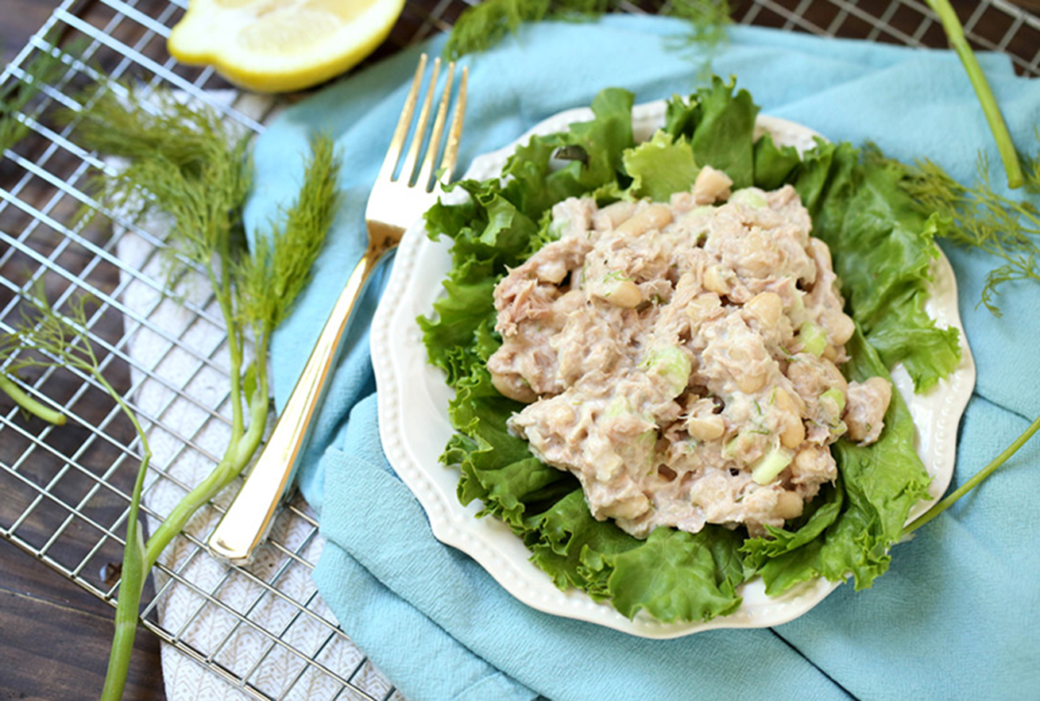
Serve a full tablespoon of tuna salad on a large lettuce leaf or spread it in a sandwich with lettuce and tomato.
(Alessio Todeschini)

Slide 102
CHOCOLATE SALAMI

Slide 103
CHOCOLATE SALAMI TRADITIONAL RECIPE
Preparation time: 30 min
Cooling time: 4 h
For 10 people
INGREDIENTS
-300 g dry plain biscuits
-150 g butter
-200 g dark chocolate
-2 eggs
-100 g sugar
-1 small glass of rum ( optional )
-icing sugar
To be continued

Slide 104
preparation
Step 1) Crumble the biscuits. Use your hands to do this because you have to feel the cookie inside the salami when you eat it.
Step 2) Melt the dark chocolate in bain-marie.
Step 3) Make a cream with the butter. Then add sugar.
Step 4) Add the eggs. Mix well until you get a homogeneous cream.
Step 5) Add the chocolate. Now you can add the rum but it is optional. Mix the mixture.
Step 6) Add the chocolate cream to the chopped cookies and mix.
Step 7) Place the mixture on baking paper and give it a cylindrical shape.
Step 8) Put chocolate salami to cool in refrigerator for at least four hours. Serve chocolate salami cut into slices.
(Vittoria Verga)

Slide 105
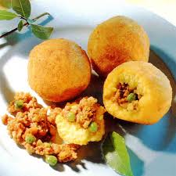
ARANCINO O ARANCINA
To be continued

Slide 106


INGREDIENTS
FOR THE RAGU FILLING
SALT TO TASTE
BLACK PEPPER TO TASTE
ONIONS ½
BUTTER 25 G
GROUND PORK 100 G
EXTRA VIRGIN OLIVE OIL TO TASTE
TOMATO SAUCE 200 ML
PEAS 80 G
FRESH CACIOCAVALLO 50 G
RED WINE 50 ML
Saffron 1 sachet
Butter 30 g
Vialone nano rice 500 g
Sale up to 1 pinch
Water 1.2 l
Caciocavallo seasoned to grate 100 g

Slide 107
HOW TO PREPARE
THE RAGOUT
Finely chop the onion and fry in a drizzle of oil
Add the minced pork and veal and brown over high heat
Also add the peas and mix well
Deglaze with white wine
Dissolve the tomato paste in a glass of water and add to the meat
Lower the heat, season with salt and pepper and cook until the broth is reduced to cream, then turn off the heat and leave to cool
Cut the provola into cubes, so you can add it inside the arancina together with the ragout (optional)

Slide 108
Prepare the rice:
In a saucepan, put the broth, butter, saffron and salt
When the broth is boiling, add the rice and mix well
Cover and cook over low heat until the rice absorbs all the broth and is cooked al dente
when cooked, stir in some cheese (optional), pour the rice on a cold surface and spread evenly to allow rapid cooling
When the rice has cooled, it is ready to prepare arancine

Slide 109
Then put arancine in the batter and breadcrumbs:
In a bowl, place the flour add the egg and some water and beat well with whips. When the batter is smooth and thick, pass arancine on it. After, pass arancine in the breadcrumbs
(Edoardo Vigolo)

Slide 110
Thanks for your attention !
Le classi seconde

